Slide 1



Center for Data Science at RTI International
UNC-CH Intro to Data Science Class
April 8, 2018
Jason
Nance
Gayle
Bieler
Data
Scientist
Founding
Director
Notes:
Hello everyone, I’m Gayle Bieler and this is data scientist Jason Nance, and we’re so happy to talk to the your intro to data science class today!
I’ve had many adventures in my 31 years at RTI International, but by far the most challenging and fulfilling has been building the Center for Data Science for the past 7 years. I was trained in traditional statistics, but I soon discovered that I had a bent toward the unconventional. At RTI, I learned to have an open mind, that the things that are unfamiliar at first are the very things that may soon prove fascinating. You just don’t know what you don’t know—you need to be prepared to change and grow and take right turns during the course of your career. That was an invaluable lesson.
But I’ll start in the beginning, with RTI itself. Most of you have hopefully heard of us, our HQ are right down the road. We have the great fortune of being housed in a brand new state of the art building called Horizon—filled with natural light, it’s a modern environment designed for collaboration. It’s a big moment for our organization.

Slide 2


RTI International
RTI International is an independent, nonprofit research institute dedicated to improving the human condition.
We combine scientific rigor and technical expertise in social and laboratory sciences, engineering, and international development to deliver solutions to the critical needs of clients worldwide.
Notes:
What is RTI? Non-profit research institute whose mission to improve the human condition.
We deliver independent, objective, and scientifically rigorous res, dev, and tech services to support projects around the world.
In today’s parlance, we are Science for Good.

Slide 3
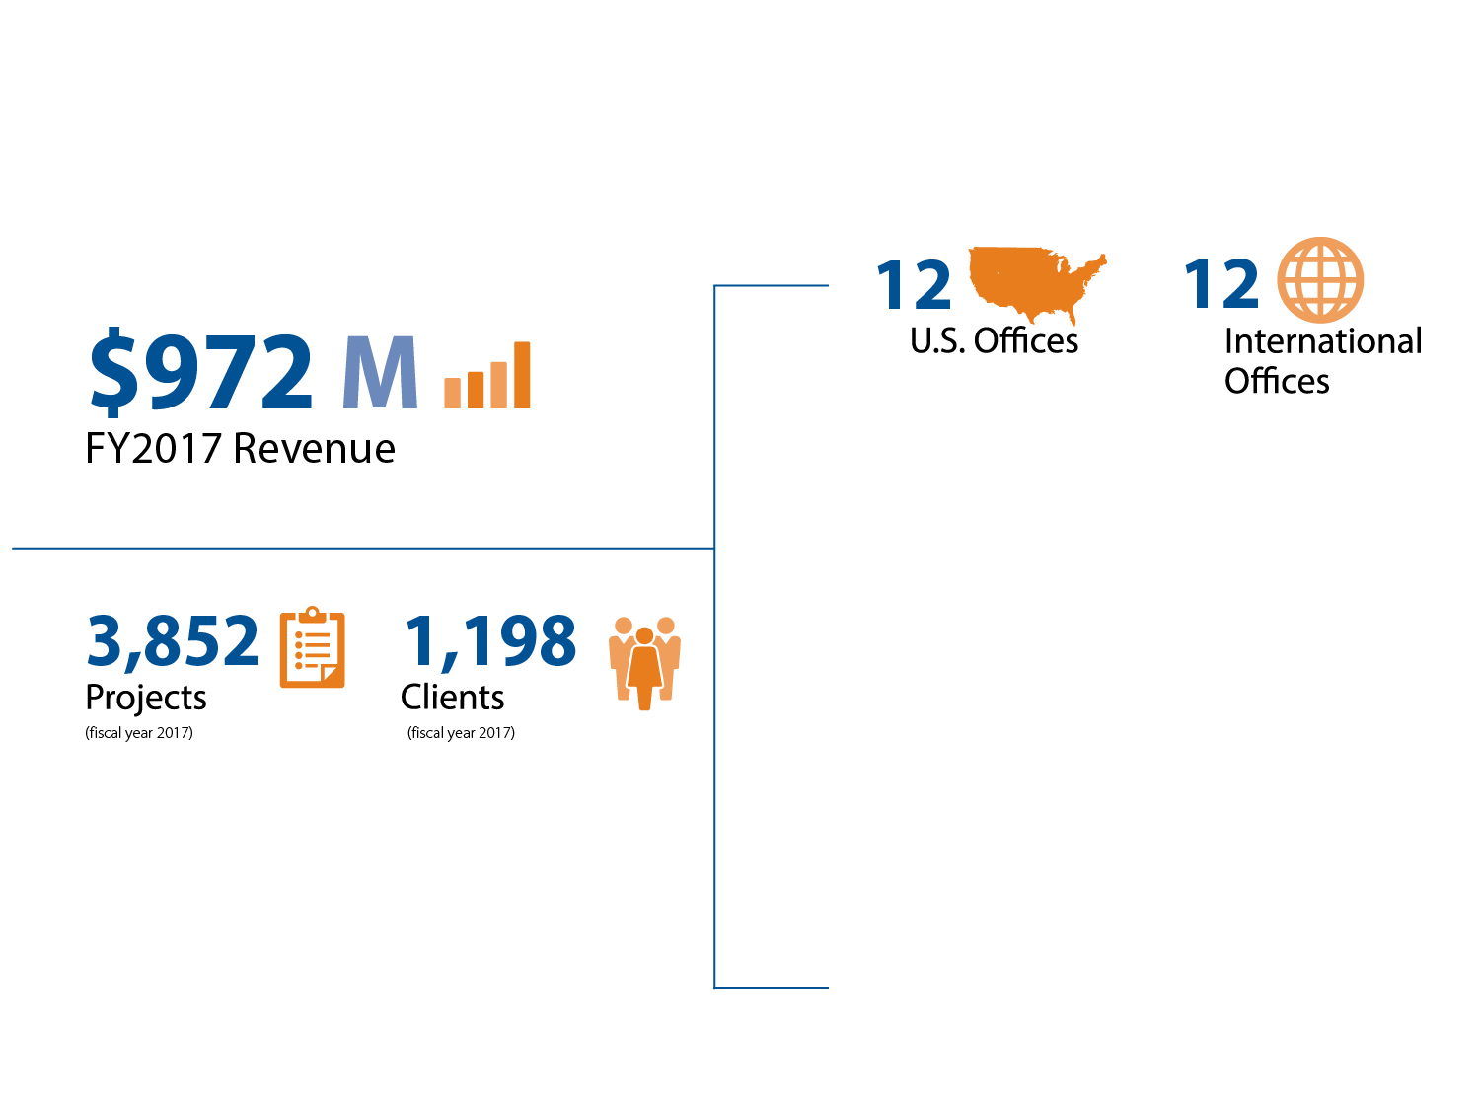
RTI at a Glance
Worldwide Presence and Financial Strength
Research Triangle Park, NC
Ann Arbor, MI
Atlanta, GA
Berkeley, CA
Chicago, IL
Fort Collins, CO
Portland, OR
Rockville, MD
San Francisco, CA
Seattle, WA
Waltham, MA
Washington, DC
Abu Dhabi, United Arab Emirates
Barcelona, Spain
Beijing, China
Belfast, Northern Ireland
Jakarta, Indonesia
Kuala Lumpur, Malaysia
Ljungskile, Sweden
Manchester, United Kingdom
Nairobi, Kenya
New Delhi, India
San Salvador, El Salvador
Toronto, Canada
Notes:
We’re a large and global organization. Almost a billion dollar a year company.
5000 staff, representing 250 degree fields, and…at any given time, ~3,800 ongoing projects with over 1,000 clients around the world.

Slide 4

What We Do
Practice Areas
Multidisciplinary expertise and research insights our clients need to inform policy, practice, and programs
Public Health
Social and Justice policy
Education and workforce development
International development
Energy research
Environmental sciences
Food security and agriculture
Innovation ecosystems
Notes:
I always say our major emphasis is on public health and wellness, as well as social and justice policy. Other big practice areas include education, the environment, food security, and international development.
Our clients include federal, state and local governments, foundations, global NGOs, and commercial companies.

Slide 5

RTI Services and Capabilities
Statistics and Data Science
Ensuring the quality, validity, and reliability of data from research studies of all types.
Turning data into actionable insights.
Data Science
Survey statistics
Biostatistics
Environmental statistics
Notes:
RTI has always been a data-centric organization, and statistics is at the core of RTI’s work. So it’s been a logical extension to apply data science to every practice area, extending our boundaries into areas like computational social science, computational epidemiology, public health informatics, bioinformatics, and others.
The Center for Data Science is situated in the organization among RTI’s statisticians. That was an important choice, because we could have been situated almost anywhere in the org—among the computer scientists, in the corporate groups, or in any of the domain research groups.
Where we are says a few things:
First, we are committed to analytic rigor. Data science is many things, but putting analytic excellence at the top emphasizes its mathematical underpinnings. For the type of work that RTI does, that’s important.
Second, we’re agnostic to application discipline. With 5000 people, our data scientists have the opportunity to work across literally dozens of research domains and find their own unique interests over time. For a team of unbelievably curious and entrepreneurial people, that’s a plus.

Slide 6


A Transformation
Persistent feeling that we could use data not exclusively for acquiring knowledge but for informing action and decision-making
Solve thorny problems
Work directly with everyday people
Evolve quickly through iteration
Understand and respond to human need
DJ Patil, former US Chief Data Scientist
Make government work better for all of us
We can do this!
Notes:
So how did this happen? I was really inspired by the Obama Administration, by their commitment to science and data, and the initiatives going on at the Office of Science and Technology Policy, at 18F, the Presidents Innovation Fellows, and the USDS. Government was becoming more data-driven than a lot of companies!
And I had this growing feeling that we could use data not only for acquiring knowledge but also for informing action and decision-making
And then DJ Patil entered the scene (as the first US Chief Data Scientist): his message and approach—to solve thorny problems, work directly with and for everyday people, evolve quickly through iteration, understand and respond to human need, and making gov’t work better for all of us….
I was in.
I remember thinking: we can do this!
THIS is the trend I’m going to talk about today—it’s data science for social good, from my own perspective and experience.

Slide 7
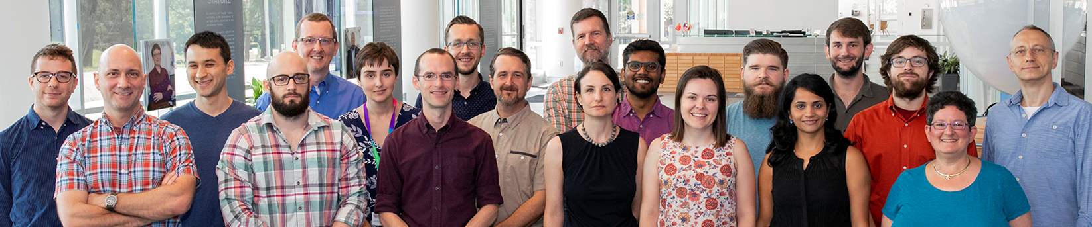
2014 to Present: RTI Center for Data Science
CDS@5: Data Science is a Team Sport
We are a vibrant team with a compelling social mission…
Data for Good
Notes:
Fast forward through a lot of hard work over a couple year period…
And in 2014: RTI establishes the Center for Data Science. Which meant me, another statistician, and a couple of new hires from the NC State Institute for Advanced Analytics.
We are now 5 years old, with 22 people. We’re growing and thriving.
We really do believe that we’re in a team sport—with ourselves, with collaborators xRTI, and with external clients. That’s just how data science rolls.

Slide 8

Mission and Vision
RTI’s mission…to improve the human condition
Our Center’s mission…to positively impact society through data science for social good
My Vision…
Create a vibrant data science team that is a hub of innovation and collaboration, where people can thrive and be at their natural best while doing meaningful work to improve the world.
We solve important national problems, improve our local communities, and transform scientific research
Notes:
And to be a great leader, I believe that having a compelling mission and vision is important.
As I’ve mentioned, at RTI we’re committed to our company’s mission…to do work that improves the human condition.
And the growing trend of Data Science for Social Good resonates with our team ... this is our cause.
Personally, I’ve always envisioned a vibrant data sci team that is a hub of innovation and collaboration, where ppl can thrive and be at their natural best, while doing meaningful work to improve the world.
In the wise words of Anita Hill, “the work we do in this regard, it’s an honor. It’s worthy of all our talents and energy.”
And in 5 years, we’ve come a long way: we’ve grown, we’ve solved important national problems, improved our local communities, published our work, presented at conferences, universities, government agencies, and at the White House. We’ve won grants, created open source tools and applications, become thought leaders in areas like data-driven justice, and appeared in local and national media.

Slide 9

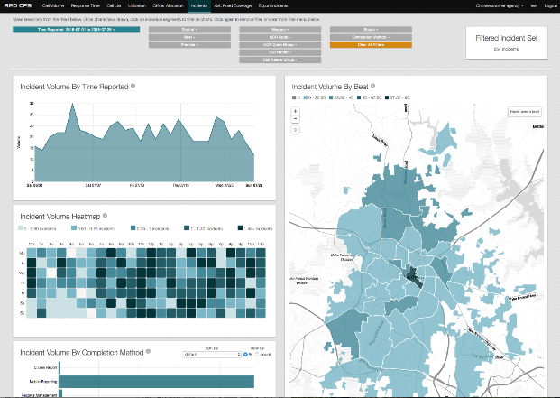

Live Your Team Values. We Are Committed To…
Continuous learning
and innovation
Creating products
that people use
Data science needs to learn
from itself
Human-centered design,
Agile software development
Practicing data science
as a team sport
Team culture,
Cross-disciplinary
collaboration
Notes:
I’ve learned that living our team values is important. To the team, it’s not just the what and why, but rather how we do it, and how it feels to work here. It’s the culture.
To that end, we believe:
First: Data science needs to learn from itself. We need to share knowledge with one another. Continuous learning and innovation are paramount.
Second: Data science is a "team" sport. The operative word here is team, and that means two things to us:
First, we, as data scientists, can only solve problems by knowing first where the problems ARE, and that requires engaging with people deeply connected to the problem space.
Second, we strive to be a team, not just a group: which means we elevate one another, we go out of our way to help one another, we mentor and develop one another.
Finally, we’re committed to human-centered design and agile software development. These are some of the hallmarks of our success. Allows us to create “products that people use.”

Slide 10
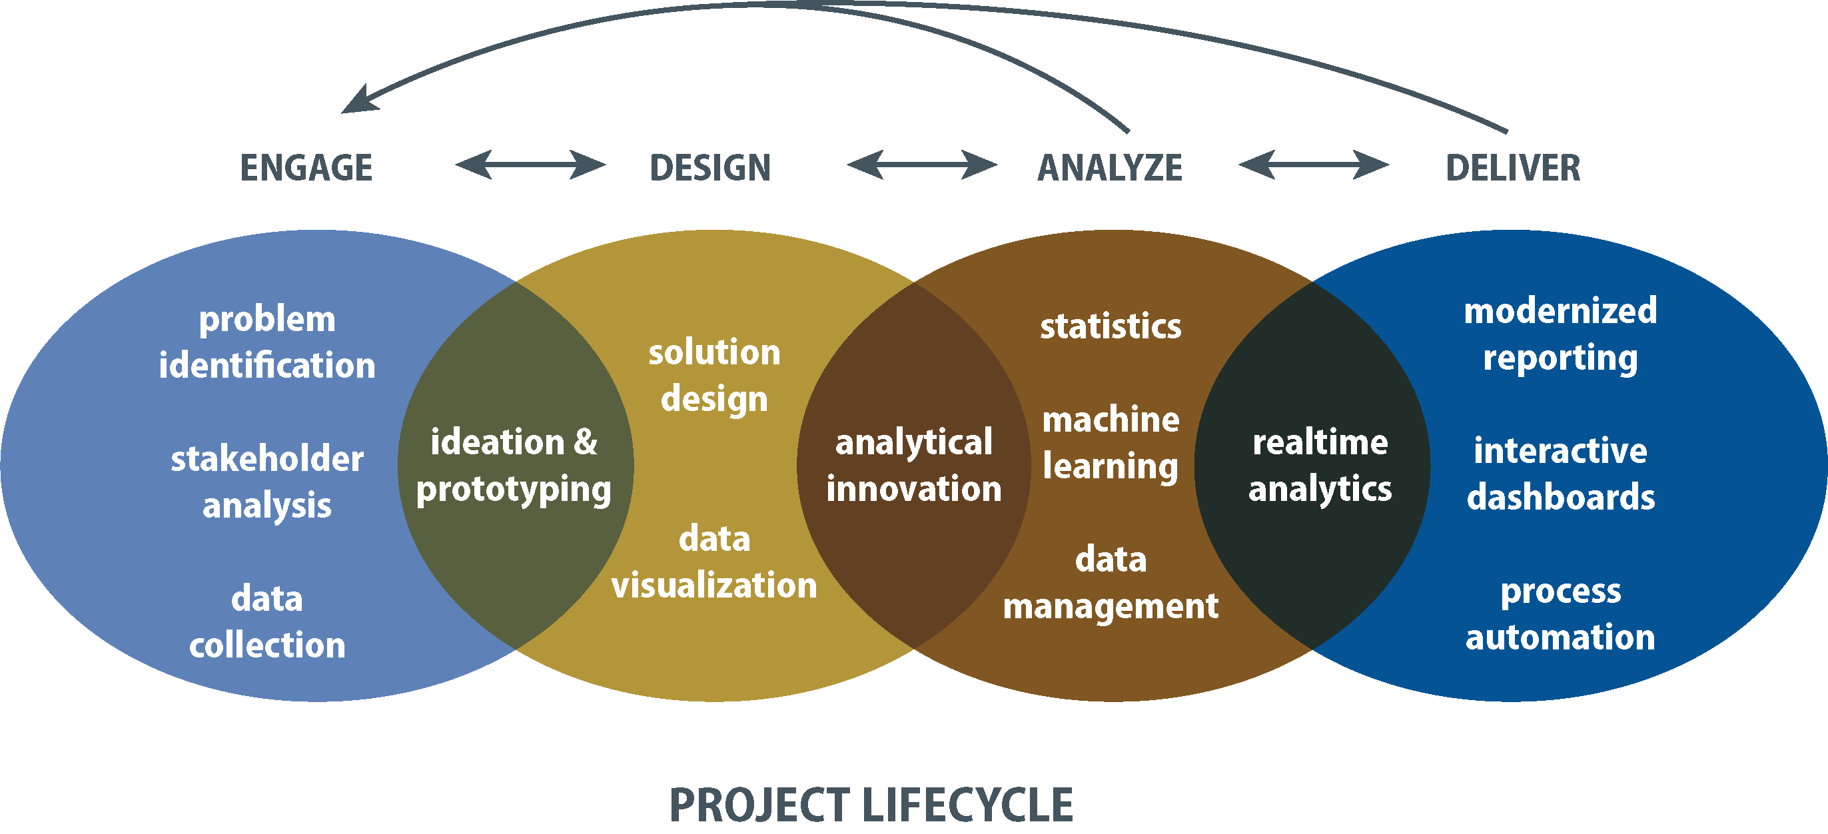
Tip to Tail Data Science
Notes:
What is Tip-to-Tail Data Science? To us, it’s data science that is deeply connected to the project lifecycle.
We approach data science as problem-solving:
Which means we start with client engagement.
We iterate with our clients to first define the problem and design solutions that fit their needs
Then continue iterating to provide actionable insight through a combination of advanced analytics, product development, and modern reporting.
To do this kind of data science, our technical skills have to include all aspects of advanced analytics, plus software engineering and visual design.
Data scientists: analytical work. They come in many different varieties, always look for humble
Software developers and data engineers: form the backbone of a data science team…important if you have a product orientation
Visual designers: elevate our visual work.
Backgrounds in various other fields is important at a place like RTI—it effectively means you speak multiple languages, which is important when working collaboratively across the organization.

Slide 11



CDS Capabilities in AI and Machine Learning
The Methods | The Integration (How)
Machine Learning Deep Learning Artificial Intelligence Agent-Based Modeling Microsimulation Text Analytics Natural Language Processing Images / Computer Vision Network Analysis | Agile Software Development Test Driven Development Continuous Deployment Continuous Integration Human-Centered Design Rapid Prototyping Process Automation ETL and Data Storage Data Pipelines
Notes:
What are our skills and capes? There is definitely more focus on analytical work than ever before.
Yes, we still do dashboards and data viz, but we’re no longer the “Center for Dashboard Science”. “They come for the dashboards, they stay for the machine learning”.
Methods (What): ML, DL, AI, Agent-based modeling/Microsim, Text Analytics/NLP, computer vision, network analysis
Integration (How): Just as important, since data science has a strong product orientation. The analytics are integrated into tools and products that people use.
We work in an agile manner, which means human-centered design and rapid prototyping, but also ensuring quality along the way—version control (Gitlab), test-driven development, CI/CD. We also do a fair amount of data engineering.

Slide 12

Collaborative Problem Solving with Data Science
Justice | Surveys
Arrest-Related Deaths Warrant Prioritization RTI STAR Traffic Stop Evaluation Tool | Geosampling: residential scene classification with satellite imagery Bandit algorithms: improving adaptive survey designs Autocoding: open-ended survey responses.
Epidemiology | Adaptable Tools
Microsimulations in diabetes, cancer, hospital acquired infections, and flu | SMART (open source project): AI-Assisted labeling of training data TAP: AI-Assisted Qualitative Coding
Notes:
Where do we work: Just about everywhere xRTI
Lots of work in Justice, but also Surveys more and more (Geosampling, adaptive survey designs, automated coding problems, visual/interactive analytics tools)
Epidemiology (microsims)
Created adaptable tools: reusable stuff. AI-assisted labeling of training data, and AI-assisted qualitative coding

Slide 13
Collaborative Problem Solving with Data Science
Public Health | Education
Machine learning for medical coding from health surveys Social Media: E-cigarette user classification; Health campaign evaluations | Auto-coding school transcripts
Sensors and Engineering
Classifying personal activity using RTIs MicroPEM sensor Predicting mild TBI using data from a wearable ECG sensor Predicting childhood seizures from wearable sensors Algorithmic calibration of low cost AQ sensors with RTI’s MicroPEMs
Notes:
Sensors: health and environment

Slide 14












Professional Development
2017-2018
Data Fellow
Notes:
We encourage our staff to engage with the world.
Our recent years have been exceptional in that regard:
From grant awards (NCDS Data Fellows 2017-18) and University appointments,
to conference presentations and peer-reviewed publications,
to media visibility and releasing publicly available data products and open source projects.

Slide 15
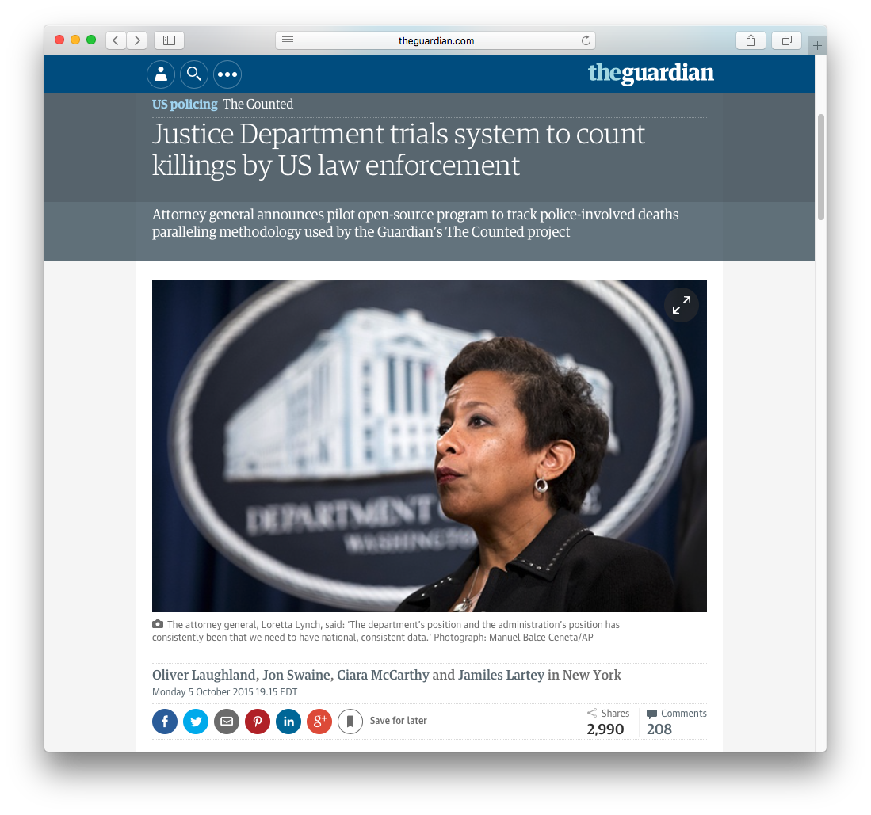
Identifying Arrest-Related Deaths: The Problem
President Obama, in response to his Task Force on 21st Century Policing, March 2, 2015:
“Right now, we do not have a good sense, and local communities do not have a good sense, of how frequently there may be interactions with police and community members that result in a death”.
Notes:
We’re going to talk in depth about a significant national problem. There’s my favorite AG, Loretta Lynch—born in Greensboro, by the way.
This project is one of the reasons I say the federal government is becoming more data-driven than a lot of companies.
On Aug 9, 2014: 18 year-old Michael Brown, a suspect in a convenience store robbery, was shot by police in Ferguson, Missouri. Protests of police brutality continued in Ferguson for more than a week. We began yet another episode in the nationwide debate about race and policing. This time, there were calls for better official data on police killings.
March, 2015: Pres Obama said, in response to his Task Force on 21st Century Policing, …“Right now, we do not have a good sense…”
October, 2015: AG Loretta Lynch and Bureau of Justice Statistics announced the start of a pilot program to change that—to provide national, consistent data to track people killed in the process of arrest by US law enforcement. BJS wanted to create a more robust version of their earlier program to count arrest-related deaths—from 2003 to 2011, they published annual data provided voluntarily by the 18,000 US law enforcement agencies. It was intended to be a Census of all deaths that occur in the process of arrest—from apprehension to detention, and all manner of deaths, not just police shootings.
So what is an arrest-related death? The term “arrest-related” encompasses the range of circumstances pertaining to a death, including those that occur from the process of apprehension to detention. So the event causing the death can occur before, during, or after arrest, and it is all manner of deaths, not just police shootings.
Law enforcement homicides
Other homicides
Accidents
Suicides
Deaths due to natural causes
/* State Reporting Coordinator (SRC) model:
A central reporter in each state was responsible for identifying and compiling information about each qualifying death occurring during the process of arrest. BJS provided the SRCs with guidance on methods to use to identify, qualify, and report data. SRCs had some degree of flexibility in compiling this information and took advantage of the relevant sources available to them in their states.
*/
October 5, 2015
http://www.theguardian.com/us-news/2015/oct/05/justice-department-trials-system-count-killings-us-law-enforcement-the-counted
As the FBI, Justice Department, the Administration’s Task Force on 21st Century Policing, and lawmakers have called for a need to have “national, consistent data” to track people killed in the process of arrest by US law enforcement, the Bureau of Justice Statistics has quietly launched a count it hopes will be comprehensive.

Slide 16
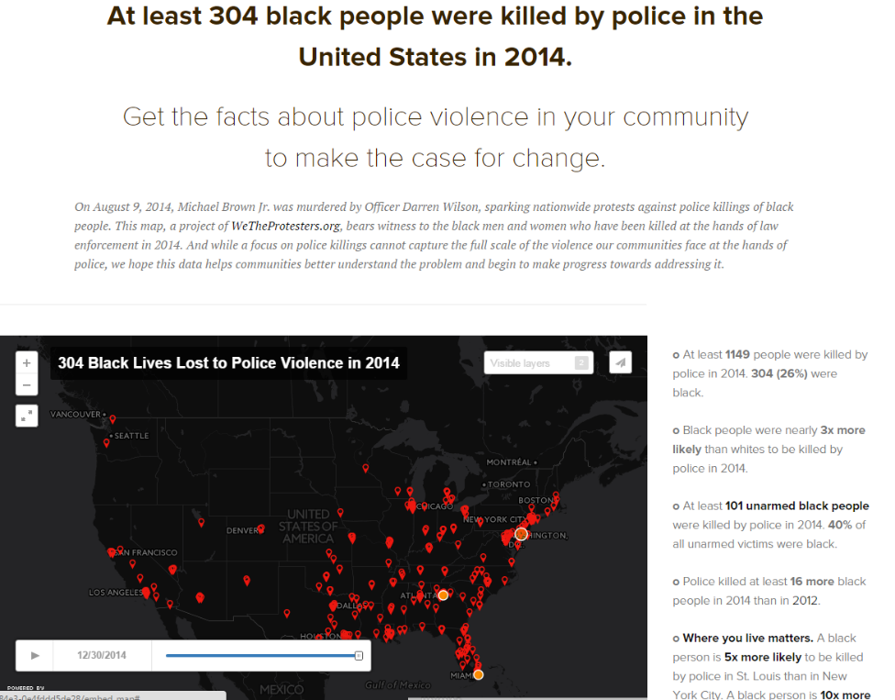
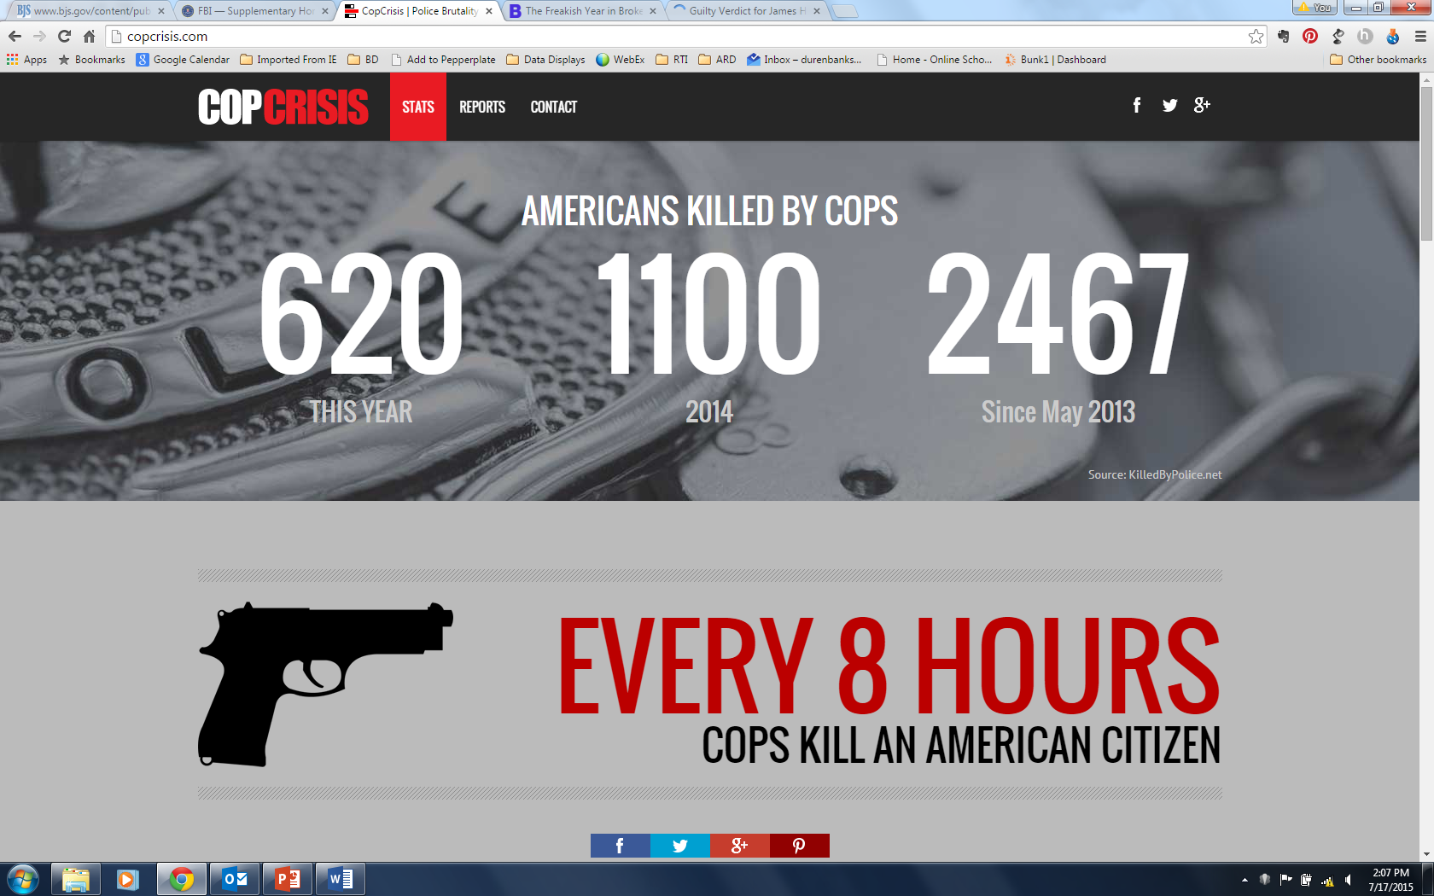
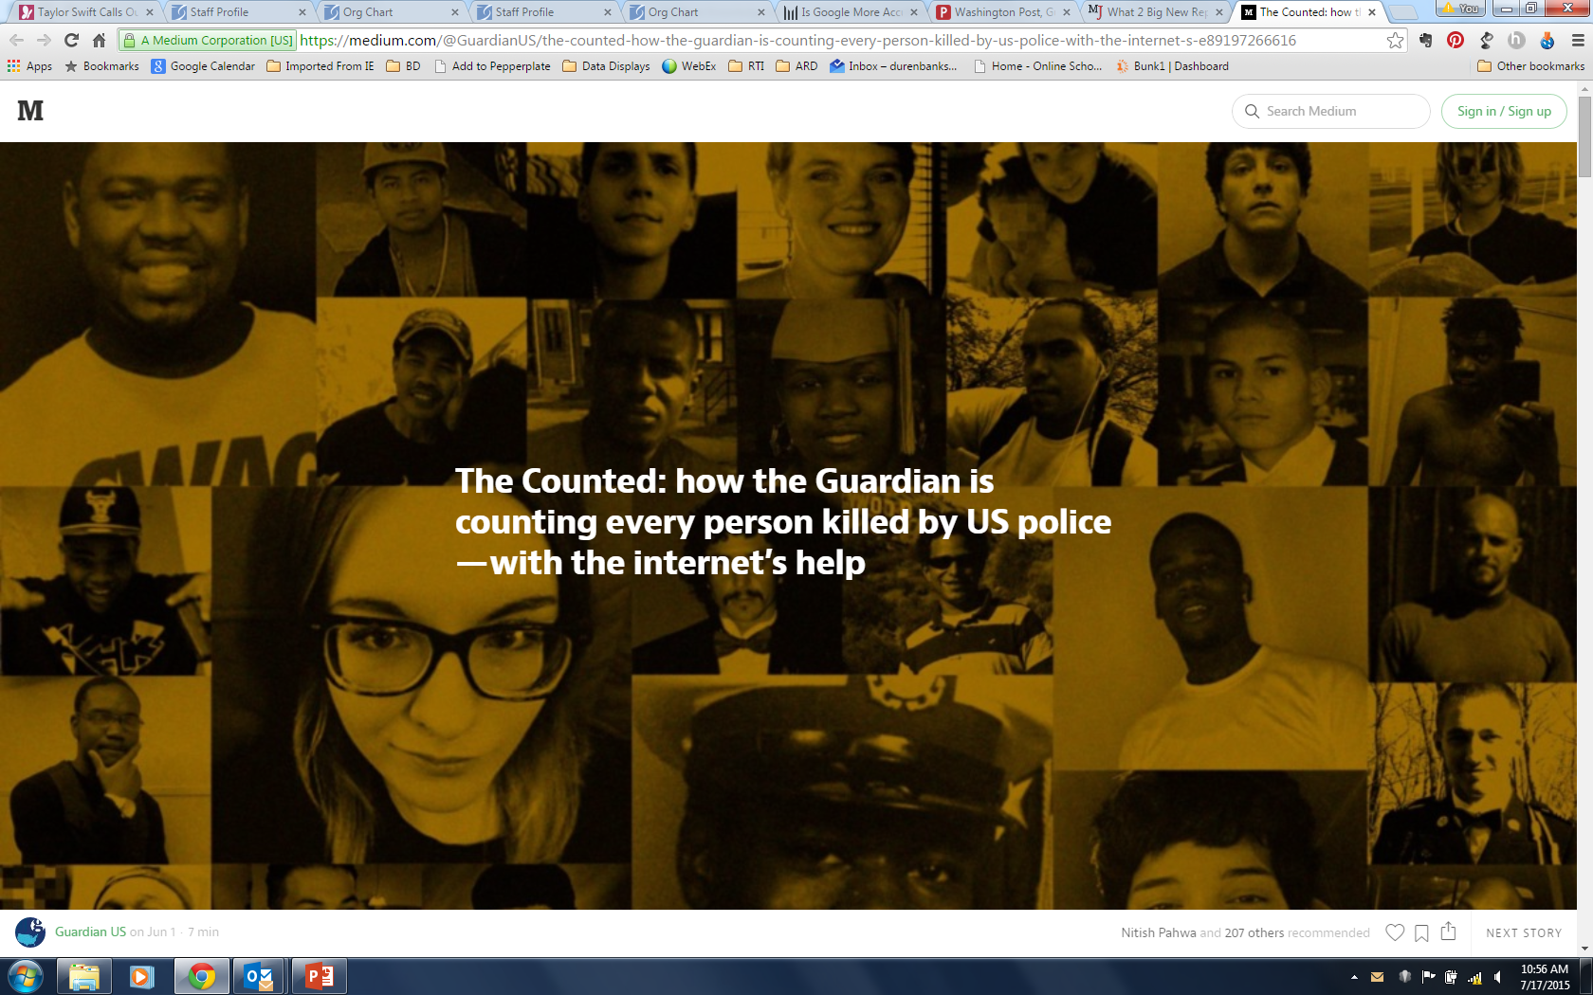
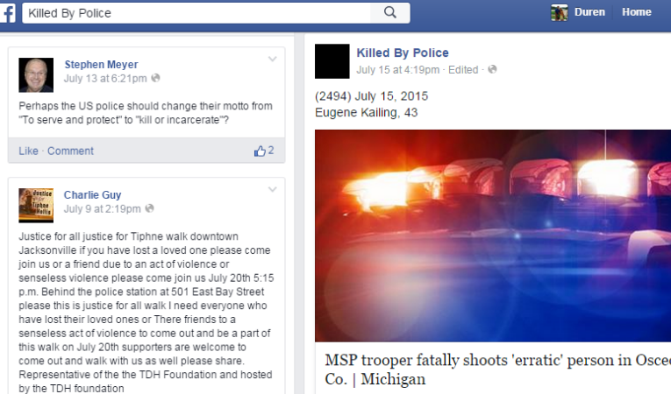
Crowd-Sourced Lists
Notes:
By 2014, crowdsourced lists were doing a better job than the federal government’s voluntary approach.
The Guardian: “The Counted”
Washington Post: “Fatal Force”
CopCrisis
FB page: “Killed by Police”

Slide 17
BJS coverage assessment findings
Estimated number of homicides by law enforcement
Reported number of homicides by law enforcement
Source: Banks, D., Couzens, G.L. & Planty, M.G. (2015, October). Assessment of Coverage in the Arrest-Related Deaths Program (NCJ 249099). Bureau of Justice Statistics, US Department of Justice.
Notes:
A coverage study conducted by RTI for BJS indicated that the counts through 2011 were seriously underestimating the true number of arrest related deaths.
BJS did a coverage assessment study: Capture-Recapture analysis, using their data and the FBI’s data (ARD and Supplementary Homicide Reports). Overlap between the two sources of data
Showed that their program was seriously underestimating the number of arrest-related deaths.
Slightly less bad in 2011 when BJS started using Google searches.
So they knew they could do better

Slide 18
ARD Program 2015 Redesign: Hybrid Approach to Data Collection
Phase 1: Identification
Review news alerts and other public sources for potential arrest-related deaths.
Track efficiency and coverage of various approaches for identifying arrest-related deaths.
Compile quarterly lists of potential arrest-related deaths.
Phase 2: Agency survey
Conduct follow-up with LE agencies and medical examiner offices to confirm identified deaths and collect more info about circumstances surrounding deaths.
Survey agencies with identified deaths and others to assess and adjust Phase 1 identification methods.
Notes:
Enter RTI in 2015: We were asked to design a single official way to count arrest-related deaths that so far had eluded the government. DOJ was looking for an accurate, national, and consistent approach to data collection.
The idea was to use a hybrid approach starting in 2015:
Phase 1: review online media reports to identify potential officer-involved deaths
Phase 2: follow-up with a law enforcement agency and medical examiner/coroner’s office survey to verify facts about the incidents, confirm identified deaths, and to find others missed in media reports.
BTW, this unconventional approach to problem-solving in the federal government is likely to represent the future. This is a trend I see and one of the very significant takeaways from this project.

Slide 19
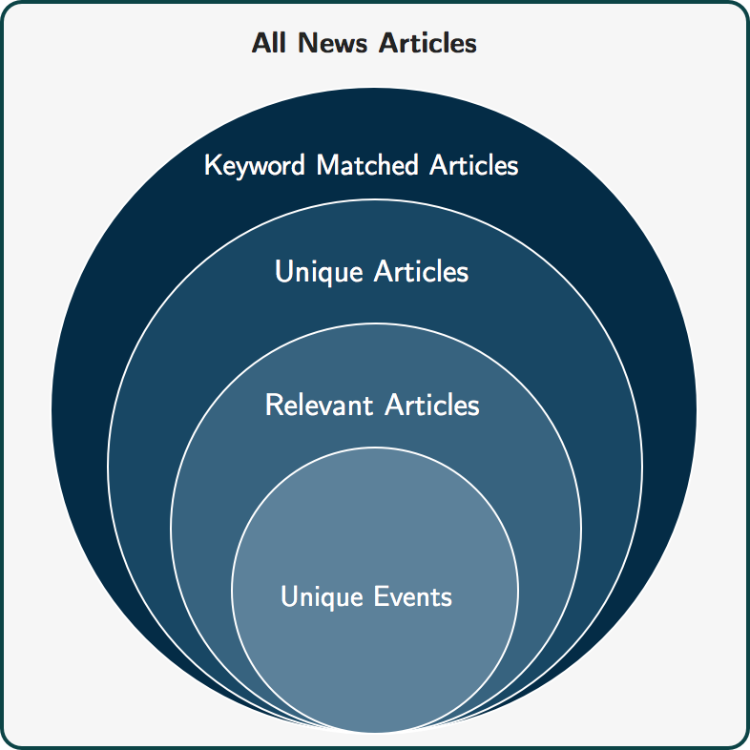
Using Open Information Sources to Estimate Arrest-Related Deaths
1,200,000 articles / month
140,000 articles / month
8,750 articles / month
99% reduction
135 unique events / month
Notes:
When this project first started, there were no data scientists on it. Just our criminologists and social scientists.
And they soon ran into a big problem:
Media alerts revealed that there were many relevant news stories to review (>1,000,000 per month)
Many human coders, many huge Excel spreadsheets, and one big headache. There was no way we could do this project relying on humans alone.
I still remember Duren Banks, the RTI PD, calling us one day:
“Hey, is there any way to reduce the number of articles we have to read? We’re drowning in news articles over here.”
The data science problem became this: can we reduce human labor without reducing the accuracy of identified decedents?
Solution:
Our data scientists created this beautiful automated coding and classification pipeline of online media data that uses text analytics and machine learning techniques to identify potential cases that can be subsequently be verified by human coders to form a comprehensive and timely count of arrest-related deaths.
In our solution, determining a potential arrest related death is the result of processing news articles through a successive set of filters. We refer to this set of article filtering processes as the pipeline.
It starts with the universe of all news articles and ends with unique events.

Slide 20
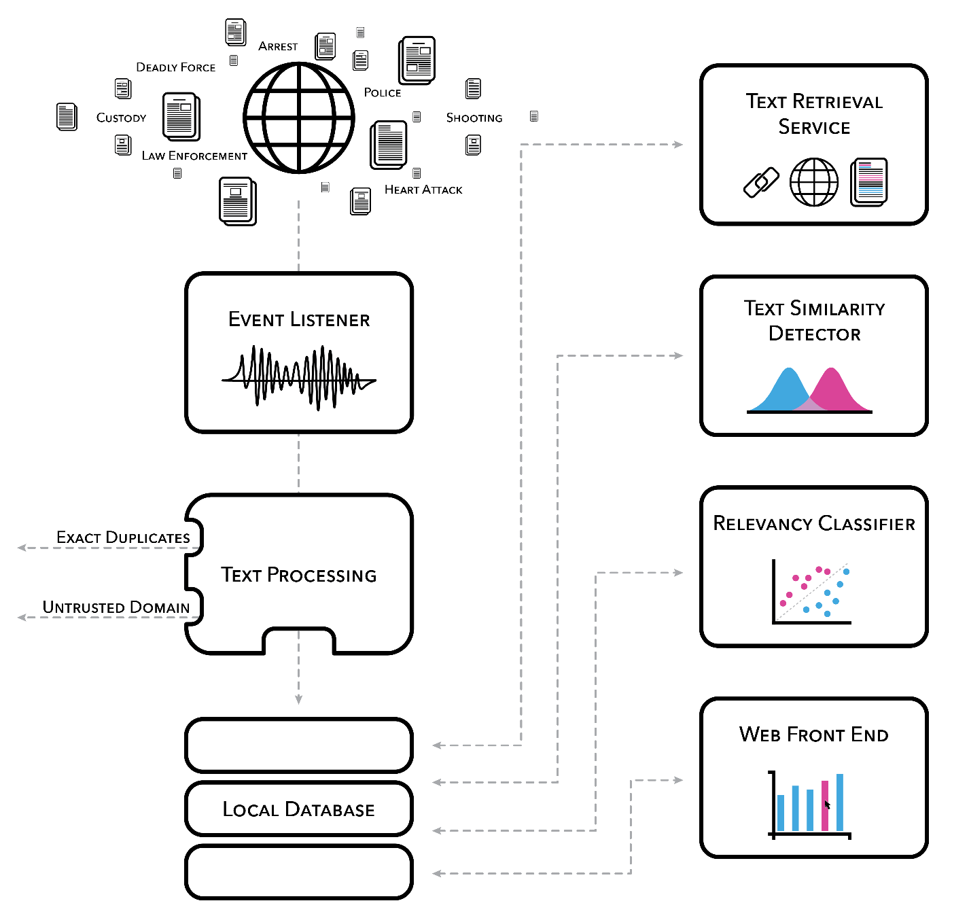
Media Alert Coding and Classification Pipeline
Notes:
Here’s a more technical view of the pipeline.
Tens of thousands of articles were ingested nightly, and various text processing steps were applied (e.g., deduplication, named entity extraction, and relevancy classification). An initial set of articles was manually reviewed and coded, and this information was used to train an ensemble of machine learning classifiers, including logistic regression, decision trees, and a neural network.
From the data science perspective, this project weaves data and analytic pipelines together in creative ways. That’s what the technical aspects of data science are all about.
Aside from impact, this is what data scientists get excited about—creating products and processes that people use.

Slide 21

Event Listener
Returns articles with a combination of the primary search term and another term indicating law enforcement involvement such as "police”, "officer”, ”arrested”
Shoot(ing,er)
Kill(ed,ing)
Death, dead, died
Deadly/lethal force
Use of force
Heart attack
Accidental
Overdose
Taser, stun gun
Standoff
Notes:
The initial step of the pipeline (the Event Listener) collects news articles from media monitoring services, where the articles collected have a title or text that contains a word from a list of primary search terms (such as shot, standoff, use of force) and other terms indicating law enforcement involvement (such as police, officer, arrest, or custody)

Slide 22
Event Listener: The Problem
Data Science Problem
Many potential news stories to review
Many coders, many spreadsheets
Goal: Reduce human labor without reducing number of individuals identified
1,200,000 articles / month
Notes:
The Event Listener brings in 1.2M articles / month.
Again, the data science problem: can we reduce human labor without reducing the number of individuals identified?

Slide 23
Text Processing: Exact Duplicates / Untrusted Domains
Remove articles from certain URLs: 530k / mo
National news outlets
Non-news websites
Eliminate exact duplicates:
URLs: 80k / mo
Article texts >40 char long: 77k / mo
1,200,000 → 515,000 articles / mo
Notes:
Text Processing:
The articles are deduplicated, a process that removes articles that have significant overlap in the article title or text.
Actually removes duplicates and articles from untrustworthy or duplicative sources: no national news outlets, no Wikipedia, no Reddit, no Breitbart
Down to 515,000 articles/month

Slide 24
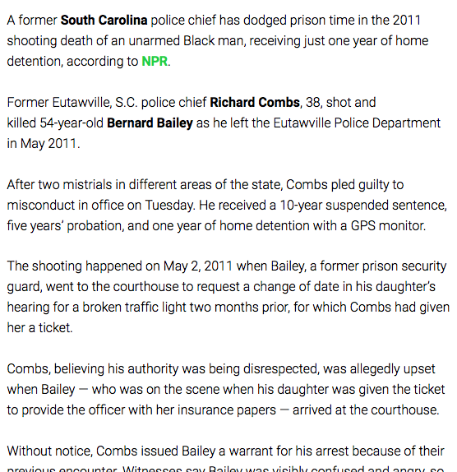
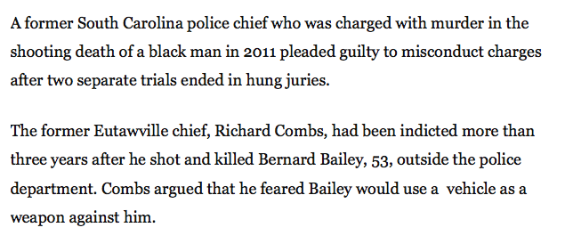
Text Similarity Detector: TF-IDF Similarity
Compute TF-IDF* similarity for all pairs of articles in 10-day sliding windows
If a pair has high similarity, drop one
Compare both texts and titles (above length limit)
270k / month reduction
*Term Frequency-Inverse Document Frequency
1,200,000 → 515,000 → 245,000 articles / month
Notes:
Text Similarity Detector: uses document similarity measures to eliminate similar articles, based on text and titles
Text Similarity Detector:
Uses TFIDF Cosine Similarity on article titles longer than 40 characters and removes articles above similarity threshold.
Uses TFIDF Cosine Similarity on article text and removes articles above similarity threshold.
Uses the set of named entities and the Jaccard similarity to remove articles above the similarity threshold.
Down to 245,000 articles/month

Slide 25
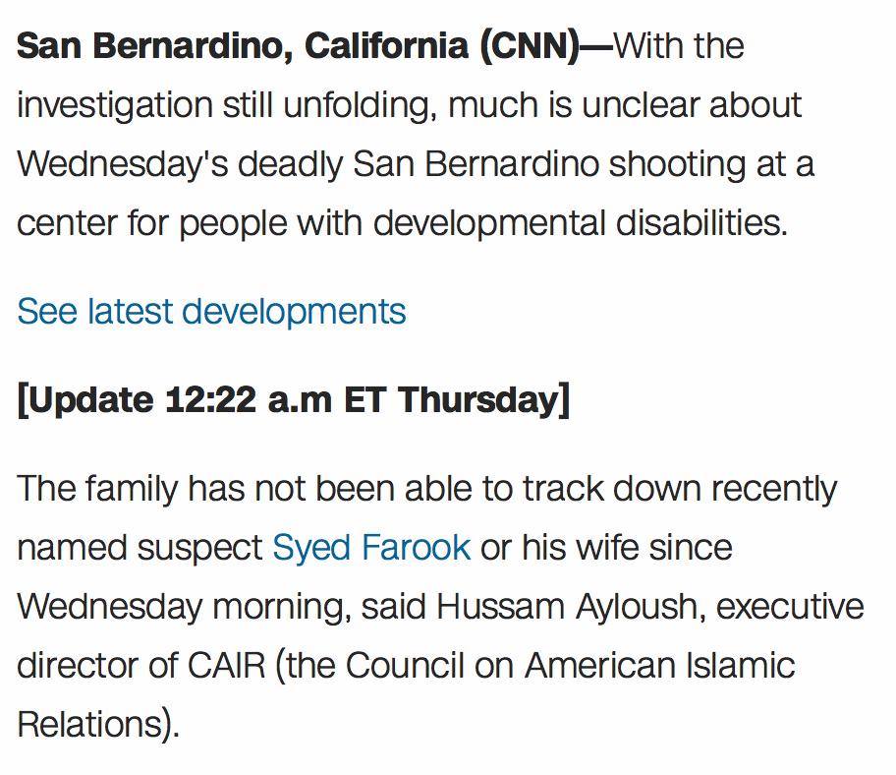
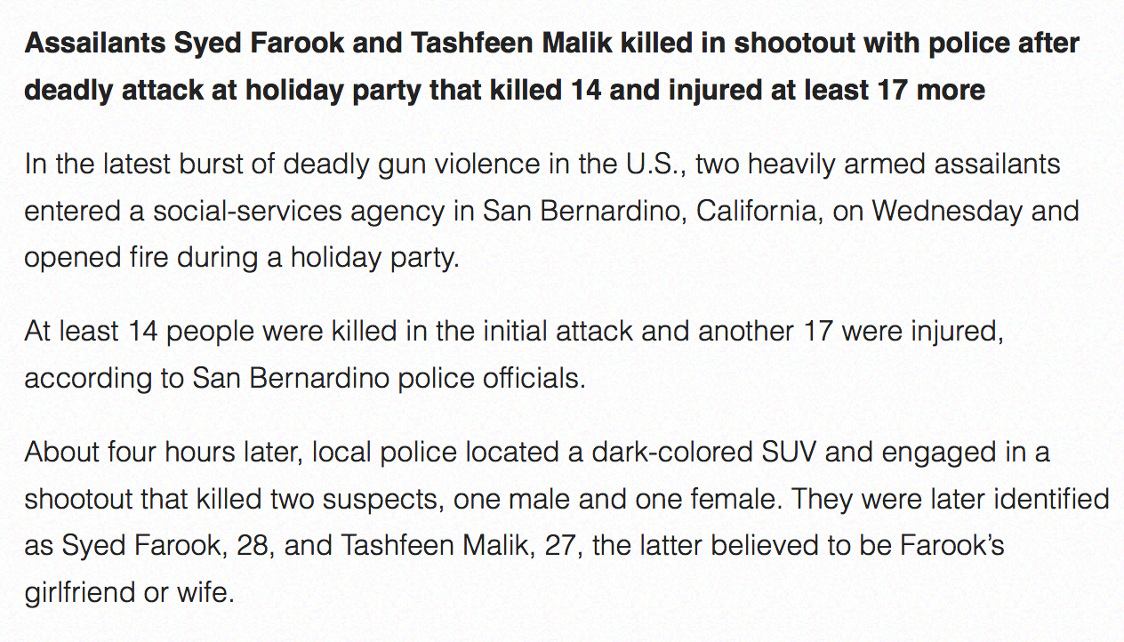
Text Similarity Detector: Entity Similarity
Generate set of named entities mentioned in each article
If sets are similar enough, drop one article
Compare texts only
105k / month reduction
1,200,000 → 515,000 → 245,000 → 140,000 articles / month
Notes:
Text Similarity Detector also looks for those with similar named entities: proper nouns
Down to 140,000 articles/month

Slide 26
Relevancy Classifier
Ensemble model (logistic regression, decision tree classifiers, and a neural network)
Separate models applied to text and title
Words positively associated with arrest-related death
“shot and killed”, ”armed”, “died”, “suspect”
Words negatively associated with arrest-related death
“victim”, ”anyone with”, “police investigate”
Remaining volume after all steps: 8,750 articles / mo (99.2% reduction)
1,200,000 → 515,000 → 245,000 → 140,000 → 8,750 articles / mo
Notes:
Relevancy Classifier: Machine learning component
After duplicate articles are removed, the remaining articles are run through a relevancy classifier — a machine learning model that predicts whether the article describes an arrest related death.
By design, the classifier efficiently filters out articles it is confident are irrelevant. However, a large number of articles are not eliminated by the machine learning model, and they may or may not be about arrest related deaths; the model is less certain about their relevancy. Those articles remain.
A human coder makes the final determination of whether all remaining articles meet the definition of an arrest related death, and then links multiple articles to a specific decedent, all through a user-friendly web interface.
Once the unambiguously irrelevant articles are discarded by the ML classifier, we’re down to about 8,700 articles a month that need manual review, a manageable number for a small team of coders. The volume of news articles is reduced by 99.2% from the initial stage.
Through these steps, our pipeline achieved over 99% reduction in news articles needing manual review, while retaining over 95% of decedents (high accuracy rate), allowing RTI to produce a successful proof-of-concept for the first federally sponsored program counting the number of arrest-related deaths in the United States using open-source data.
A note about accuracy: maintaining accuracy while reducing human burden were both important in this project. We worked with our client to define the most important accuracy metric (in this case, at least 95% of decedents retained) and implemented checks to ensure our output remained within the acceptable amount of error. We knew we would have to continually retrain our model to maintain good performance on current and future news articles, but we also wanted to avoid biasing the model by training it against its own output. While we focused the majority of manual review on the reduced set of articles produced by our pipeline to maximize efficiency, we also labeled a 1% random sample of all articles monthly, which we used to continually validate our model. We periodically compared the model with human coders by examining a list of cases where the two strongly disagreed. Finally, we merged our results with lists of decedents from multiple external sources to confirm our false negative rate. We identified the cause of any missing decedents and tweaked parameters as necessary to ensure such mistakes would not be repeated.
/*
Machine learning classifiers were developed and trained based on an initial sample of 150,000 manually coded articles. Model updates are recurring, and articles are weighed to protect against developing a biased classifier
Separate ensemble models for article title and text produce a predicted probability of relevancy. Articles above a cutoff score are classified as relevant.
*/

Slide 27
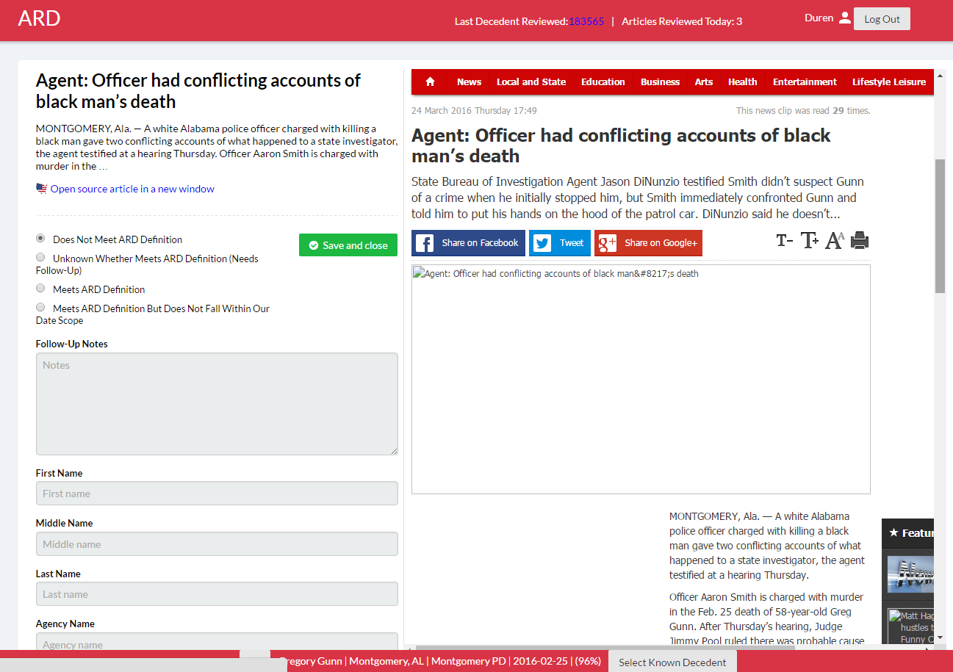
Web Front End
Notes:
Here’s the web interface I mentioned:
Through this user-friendly web interface, the remaining potentially relevant articles are presented to a team of human coders. If an article meets the definition, details about the event (e.g. decedent name, law enforcement agency) are entered through the web form, and articles covering the same event are linked.
The web interface assists with all of this. For example, there’s a feature that suggests the decedent’s name so coders don’t have to keep typing it in.
The web interface was a feature that most delighted our coders—made it so easy to do their job. Not only fewer articles, but no more spreadsheets!

Slide 28
Overall reduction in article volume
Typical monthly media alert volume (after initial text processing)
515,000
TF-IDF Similarity Detector
245,000
Entity Similarity Detector
140,000
Relevancy Classifier
8,750
Web Front End
1,250
1,250: Average number of articles / month identifying a potential arrest-related death
Notes:
Funnel that shows the reduction in articles at the various stages. After human coders are done, there are approx 1,250 articles/month identifying a potential arrest-related death.
Emphasize the labor and expense to client to review all articles.
35% of ARDs only mentioned in one news story

Slide 29
Other considerations
What to build vs. what to buy?
Acceptable amount of loss
Monitoring of manual coding (quality control)
”Unknown” queue
“Known decedent” identification and linking
Resolving disagreements between coders and the Relevancy Classifier
Comparing with external sources

Slide 30
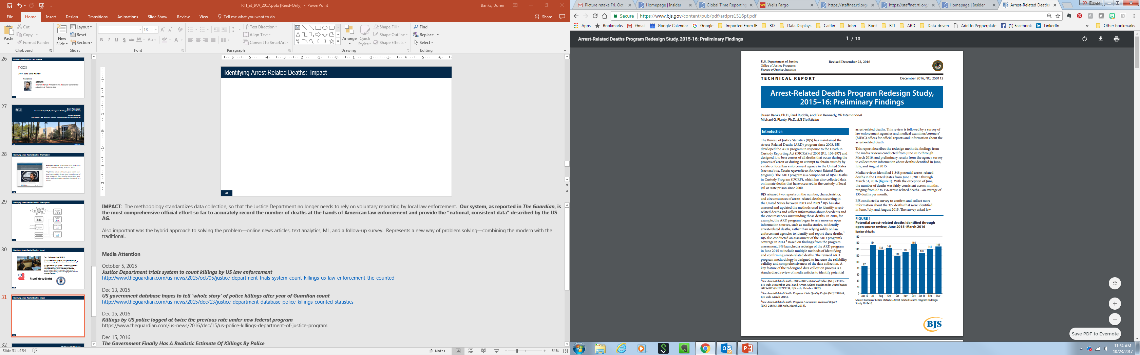
Identifying Arrest-Related Deaths: Results
Average number of law enforcement homicides identified per month in 2011 through the previous ARD program methodology
Notes:
In the 2015-16 Re-design Study, between the media review and the follow-up survey, we estimated 1,900 arrest-related deaths occurred from June 2015 through May 2016, far outpacing the previous methodology.
/*
The revised ARD program methodology is designed to increase the reliability, validity, and comprehensiveness of the data collection.
Media reviews identified 1,348 potential arrest-related deaths in the United States from June 1, 2015 through March 31, 2016. With the exception of June, the number of deaths was fairly consistent across months, ranging from 87 to 156 arrest-related deaths—an average of 135 deaths per month.
BJS conducted a survey to confirm and collect more information about the deaths that were identified in June, July, and August 2015.
Using information captured from media sources from June 2015 through May 2016 and assuming another 12% identified directly from agencies, an estimated 1,900 arrest-related deaths occurred.
*/

Slide 31
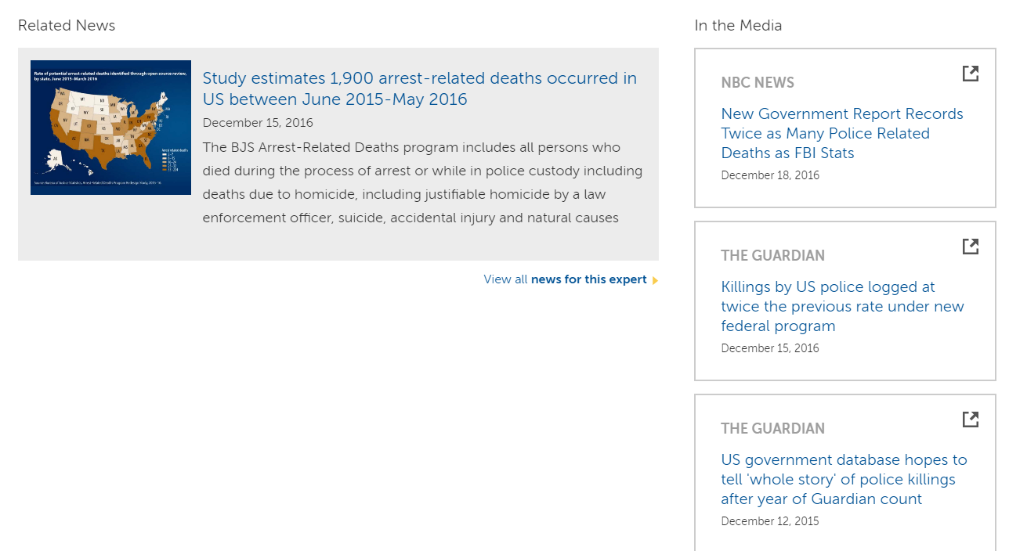
Program Findings
Technical Report:
Banks, Ruddle, Kennedy, & Planty (2016).
Arrest-related Deaths Program Redesign Study, 2015-16: Preliminary Findings. Dept of Justice, Office of Justice Programs, Bureau of Justice Statistics.
Notes:
In Dec 2016, BJS published the report, which can be found on their website.
This project has been featured in numerous media outlets, including The Guardian (2015 and 2016) and fivethirtyeight.com, who also included it among the Best Data Stories of 2016.

Slide 32



Identifying Arrest-Related Deaths: Impact
From The Guardian, Dec 13, 2015:
“We should be able to know how many people die in law enforcement custody”
“We couldn’t have done this 30 years ago. Now, because we have all this information available online in a machine-readable context, we are able to narrow down the universe of articles or posts initially without having a person read the universe of articles.”
Notes:
Why is this project important:
The methodology was successful in standardizing data collection, so that the Justice Department no longer needs to rely on voluntary reporting by local law enforcement. Our system, as reported in The Guardian, is the most comprehensive official effort so far to accurately record the number of deaths at the hands of American law enforcement and provide the “national, consistent data” described by the US AG.
Once the unambiguously irrelevant articles are discarded by the machine learning classifier, there are less than 10,000 thousand articles a month that need manual review, a manageable number for a small team of human coders. Through these steps, our pipeline achieved over 99 percent reduction in news articles needing manual review, while retaining over 95 percent of decedents (high accuracy rate), allowing RTI to produce a successful proof-of-concept for the first federally sponsored program counting the number of arrest-related deaths in the United States using open-source data.
Broader Perspective:
As I mentioned, this hybrid approach to problem-solving is likely to represent the future (at least in the applied research business that we’re in). Solutions can range anywhere from the traditional on one end (what we think of as primary data collection for research purposes) to the unorthodox (however you define it—found data, digital exhaust, combined with machine learning, AI) on the other end, to every combination of the two approaches in between. There can potentially be many workable solutions to any given problem. The solution presented here is important because it’s not something we could have done 30 years ago. Societal problems may remain the same, but the solutions are re-invented.
Media Attention
This project has been featured in numerous media outlets, including The Guardian, fivethirtyeight.com (who also included it among the Best Data Stories of 2016), and others (e.g. The Measure of Everyday Life podcast).
October 5, 2015
Justice Department trials system to count killings by US law enforcement
http://www.theguardian.com/us-news/2015/oct/05/justice-department-trials-system-count-killings-us-law-enforcement-the-counted
Dec 13, 2015
US government database hopes to tell 'whole story' of police killings after year of Guardian count
http://www.theguardian.com/us-news/2015/dec/13/justice-department-database-police-killings-counted-statistics
Dec 15, 2016
Killings by US police logged at twice the previous rate under new federal program
https://www.theguardian.com/us-news/2016/dec/15/us-police-killings-department-of-justice-program
Dec 15, 2016
The Government Finally Has A Realistic Estimate Of Killings By Police
https://fivethirtyeight.com/features/the-government-finally-has-a-realistic-estimate-of-killings-by-police/
Dec 29, 2016
The Best and Worst Data Stories of 2016 (Trudeau Prize for Governance)
https://fivethirtyeight.com/features/the-best-and-worst-data-stories-of-2016/
July 26, 2017
Artificial Intelligence and Arrest-Related Deaths
http://measureradio.libsyn.com/artificial-intelligence-and-arrest-related-deaths

Slide 33
Made Possible By…
Thanks to the open source community for:
Python
pandas
spaCy
scikit-learn
Luigi
Keras
nltk
Jupyter
numpy
scipy
TensorFlow
PostgreSQL
Notes:
Our staff (which includes data scientists Jason Nance and Peter Baumgartner) are grateful for all of the open source technologies and specifically the Python libraries that made this type of project possible.

Slide 34
What else could we track from news articles?
Police use of force
Monthly volume (after initial text processing): 375,000
Deep learning models based on Facebook’s FastText embedding classification system
Title: character-level up to 4-grams
Text: word level up to 2-grams (bigrams)
Monthly volume (after applying classifier): 22,000
Hate / bias crimes
Monthly volume (after initial text processing): 560,000
Also based on Facebook's FastText embedding classification system
Monthly volume (after applying classifier): 2,000
In both cases, difficult to verify results from external sources
Notes:
The system is currently being expanded to other police-related outcomes. These new domains provide an opportunity to improve on the existing system as well as evaluate performance gains from newer deep learning based approaches for classification.

Slide 35

Thank You! Gayle Bieler Jason Nance
Questions?

